Slide 1


Slide 2
Prototyping Data Architecture using AWS
Data Lake – AWS S3
ETL – AWS Glue
Data Warehouse – AWS Redshift
Machine Learning – AWS Sagemaker (Canvas)
Analysis – AWS QuickSight

Slide 3

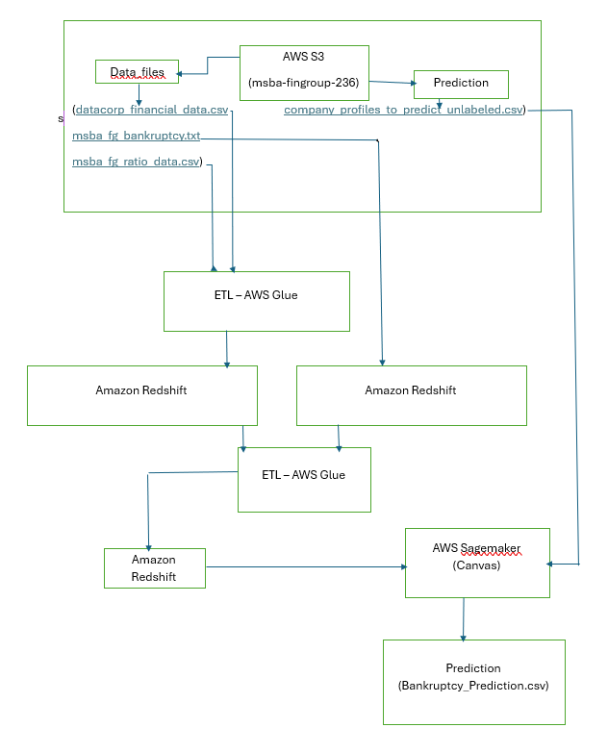
Data Architecture Flow

Slide 4

Data Lake – AWS S3
Data Management: Tools to organize, move, and manage your data.
Security: Strong security features like encryption and access controls.
Scalability and Performance: Handles large amounts of data and high request rates with low latency and high throughput.
Data Flexibility: Files such as .txt, .csv, .json, .xml., .jpg, .png, .gif, .bmp., .mp4, .avi, .mov, .mkv, .pdf, .docx, .xlsx, .pptx, .mp3, .wav, and .aac, .log, backup files and Archives.
S3 Bucket Name: msba-fingroup-236

Slide 5
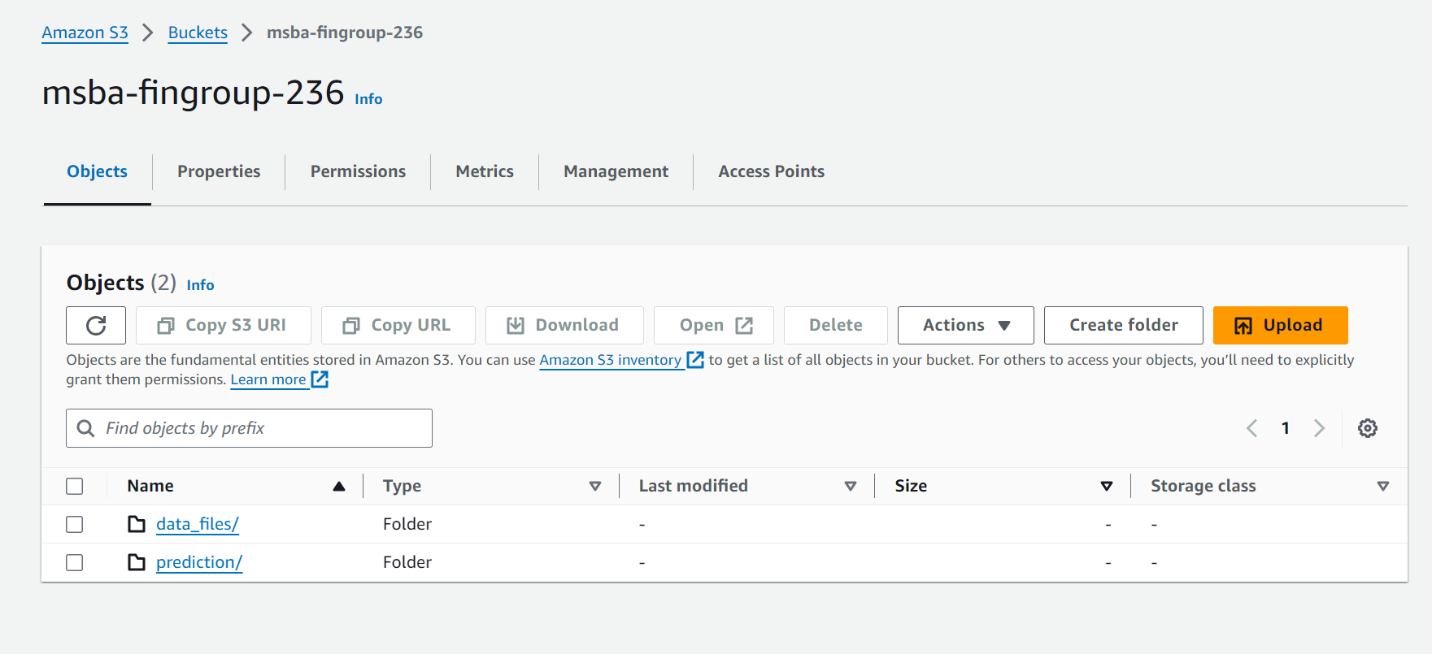
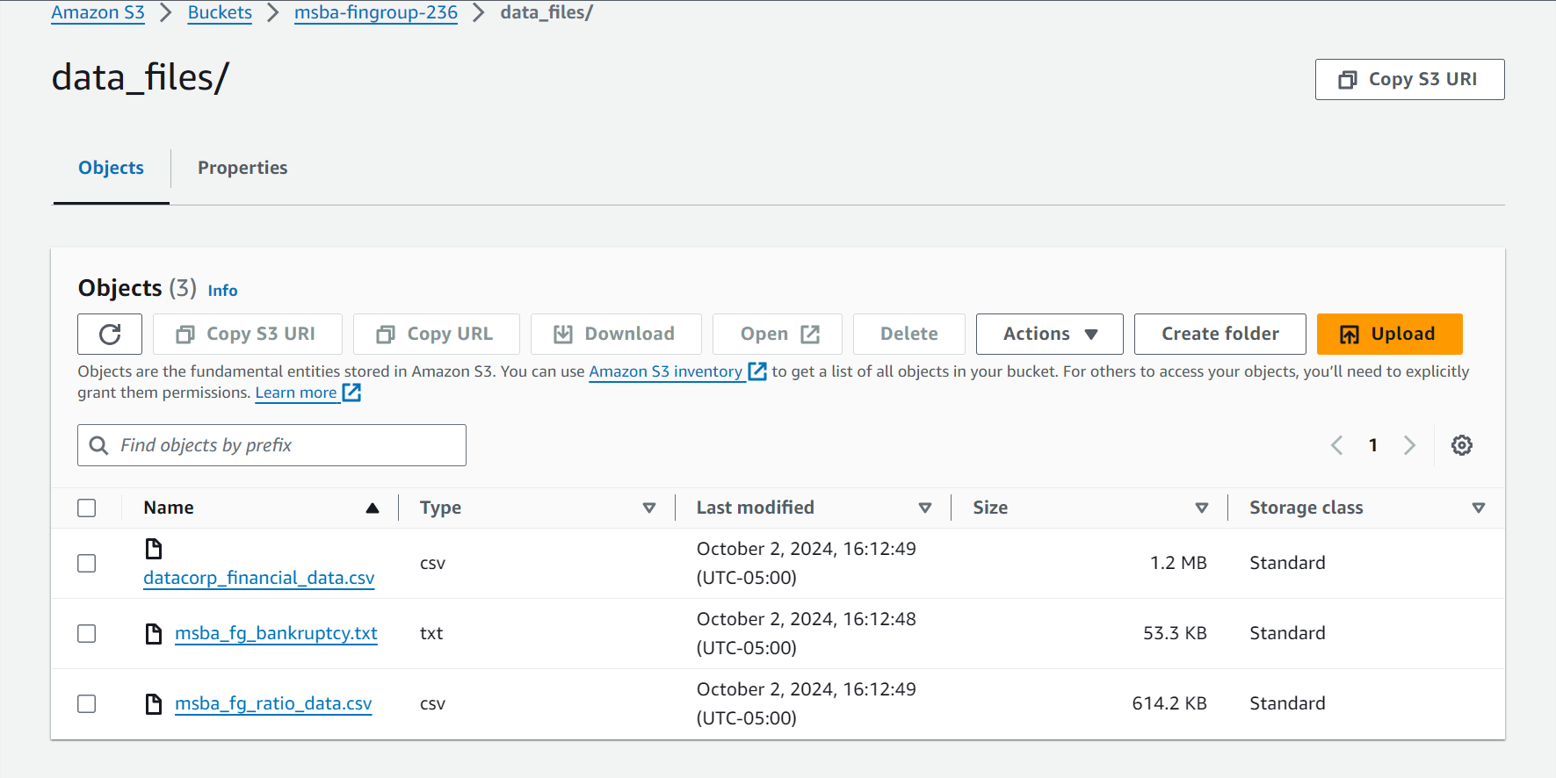
AWS S3 Data Info
Folders – data_files, prediction
Files under data_files – datacorp financial data, bankruptcy data, financial ratios data.
Files under Prediction – Unlabeled data.

Slide 6
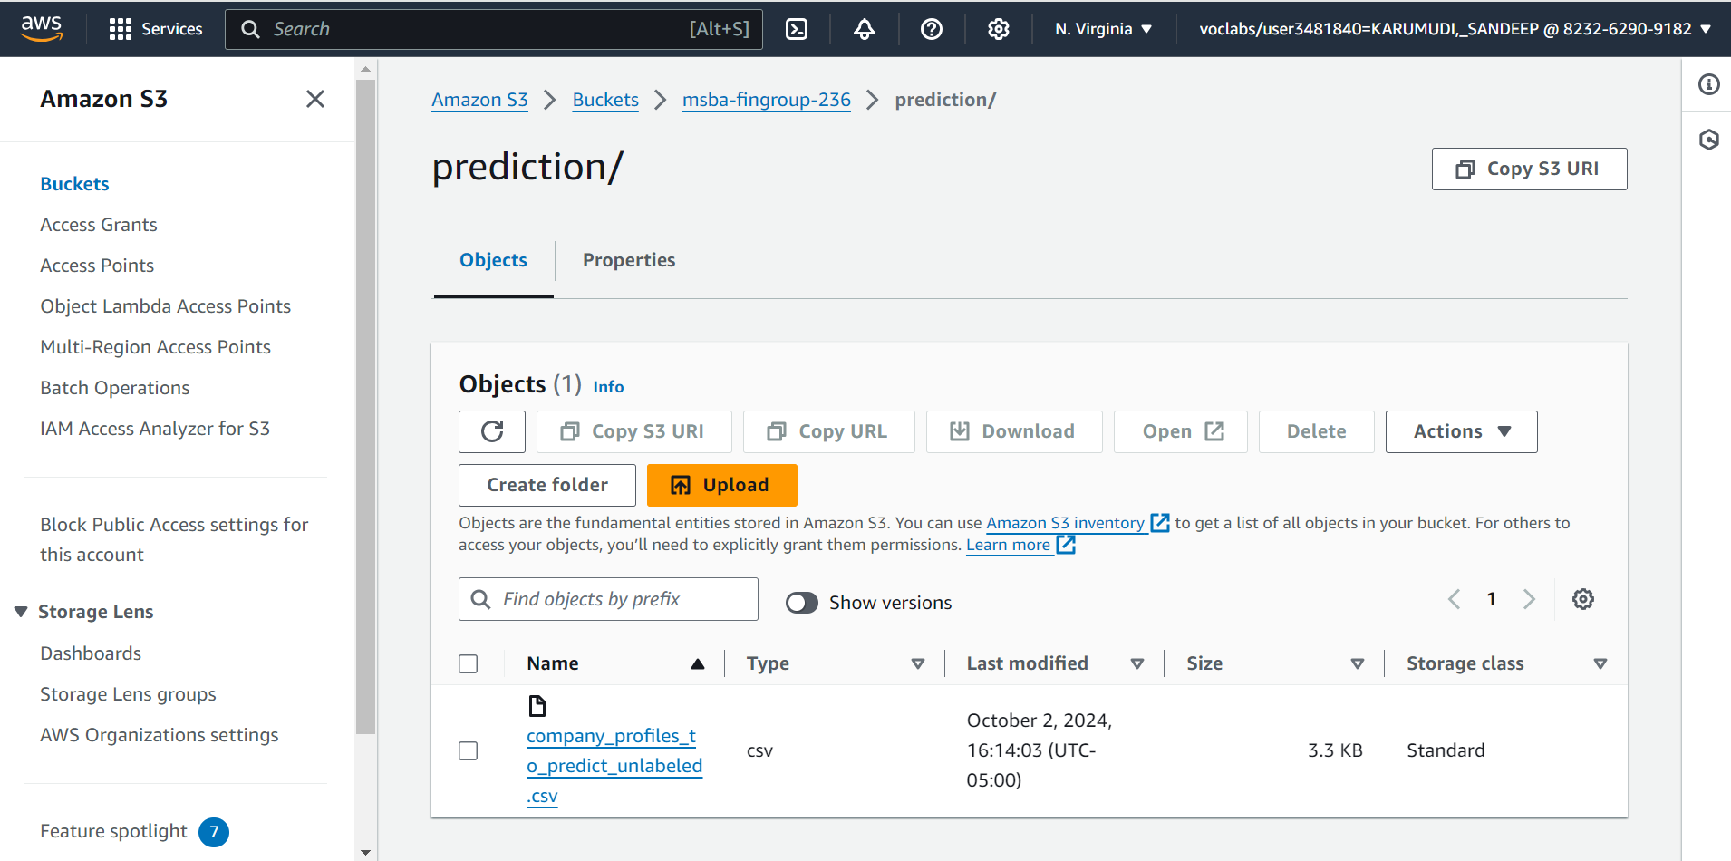

Slide 7
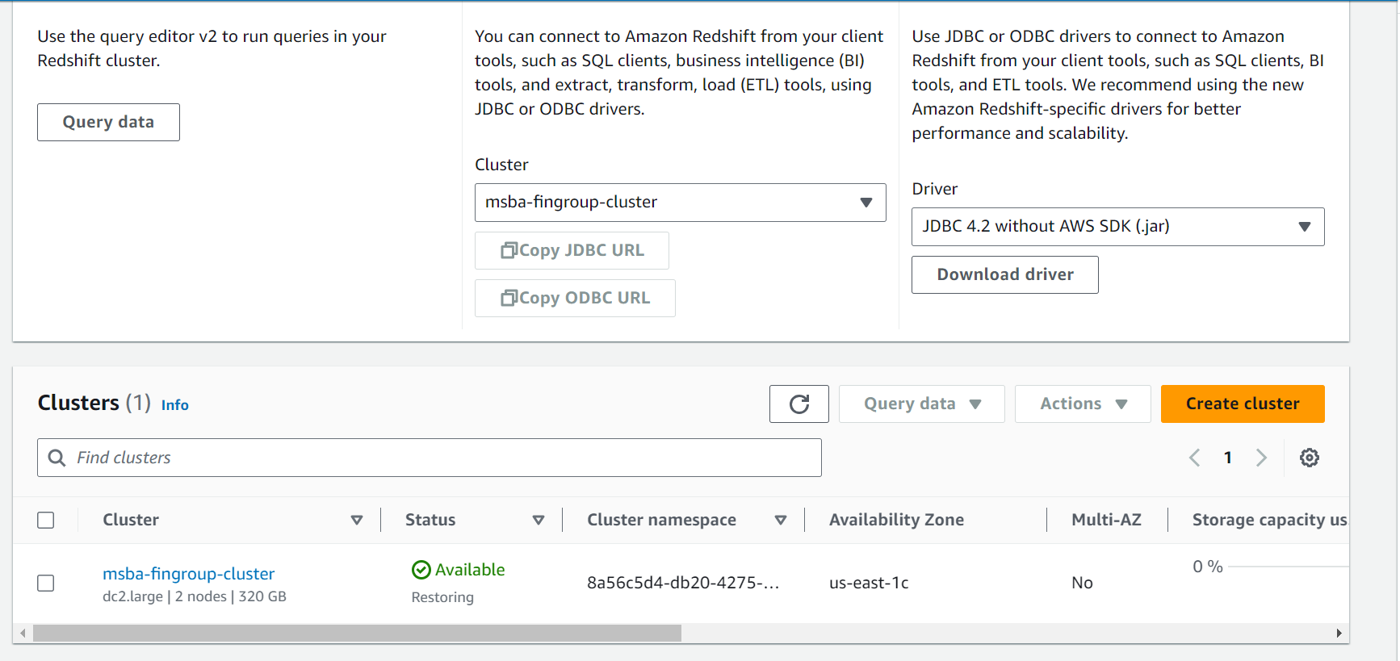
Amazon Redshift
Data Warehousing: Store and manage large amounts of data.
Fast Queries: Massively Parallel Processing (MPP).
Data Analytics: Analyze data for business insights and reporting.
Integration: Connect with other AWS services like S3, Athena, and Glue.
Cluster Name: msba-fingroup-cluster

Slide 8
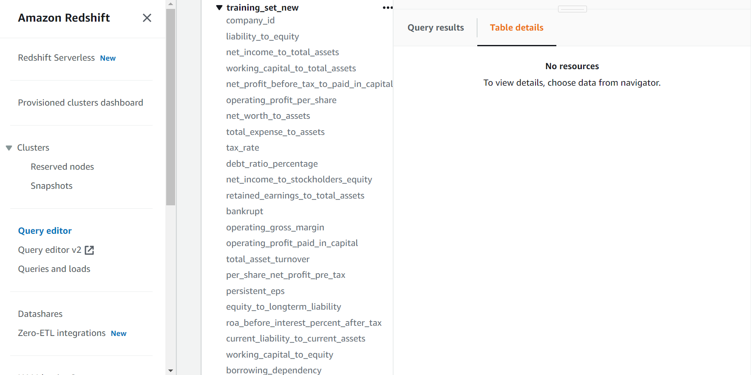

Slide 9
ETL – AWS Glue
AWS Glue: Serverless ETL service that automates the Extract, Transform, and Load process.
Data Integration: Combines data from multiple sources into one place.
Scalability: Handles large volumes of data and scales as needed.
Automation: ETL processes can run automatically on schedules or events.
Data Quality: Ensures data is clean and accurate before loading.

Slide 10
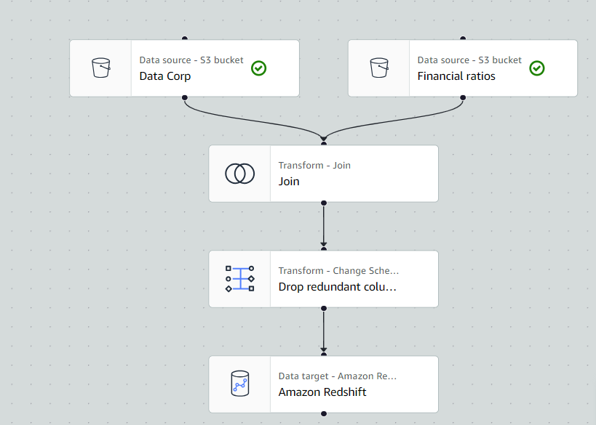
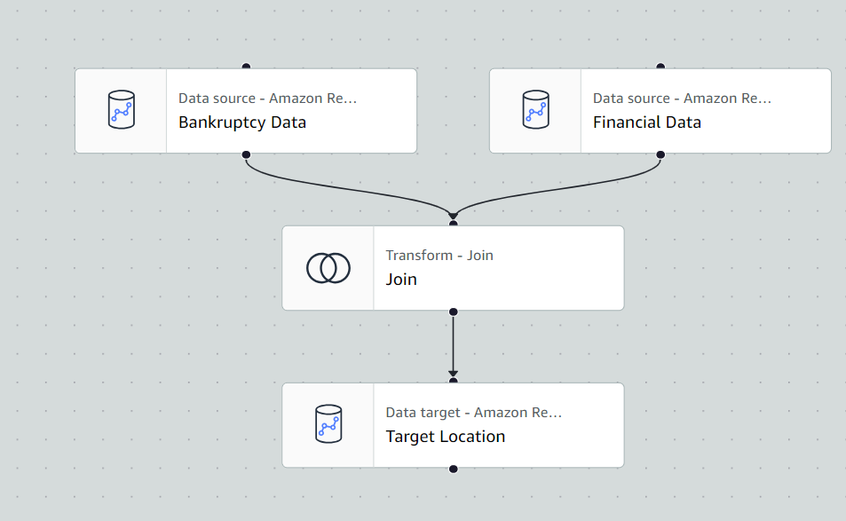
Visual ETL Flows

Slide 11
Machine Learning: AWS Sagemaker (Canvas)
Build Models: Easily create machine learning models using built-in algorithms or your own.
01
Train Models: Train your models on managed infrastructure without worrying about setup.
02
Deploy Models: Deploy trained models to a production-ready environment for real-time predictions.
03
Automate Workflows: Automate the entire machine learning workflow, from data preparation to deployment.
04
Monitor Models: Monitor and manage your models to ensure they perform well over time.
05

Slide 12
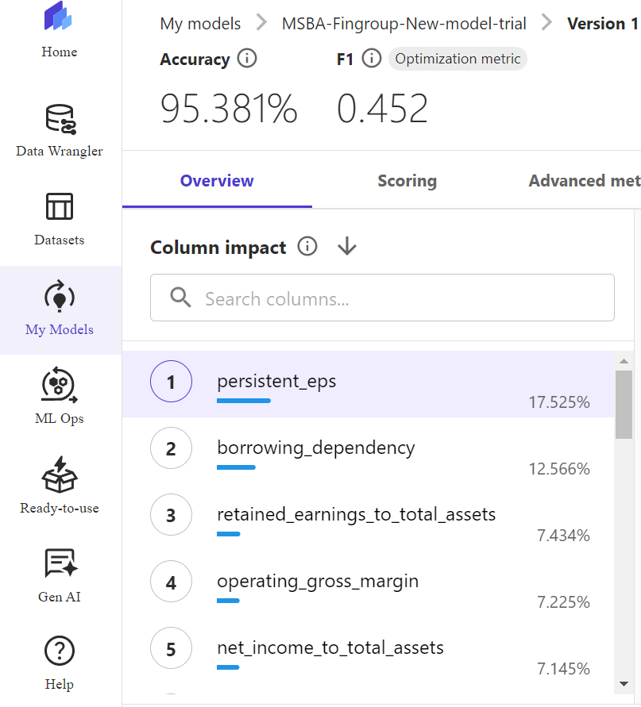
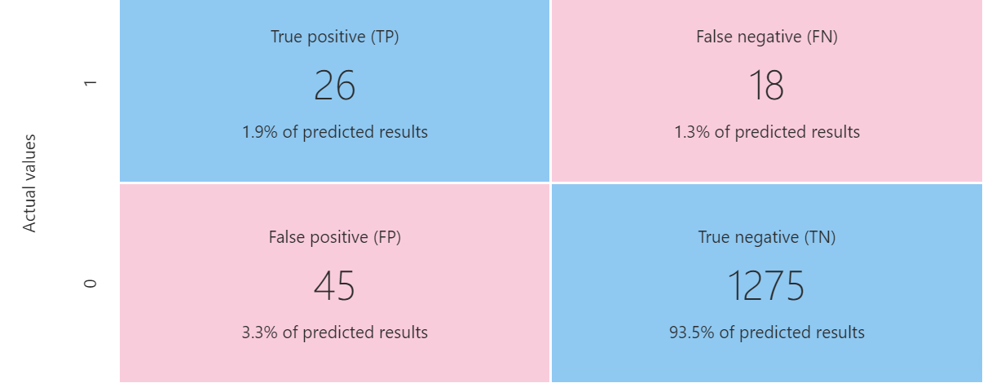
MSBA-Fingroup-Bankruptcy-Prediction-Model
Confusion Matrix
Model Accuracy – 95.381%
Column/ Attributes Impact on the prediction.

Slide 13
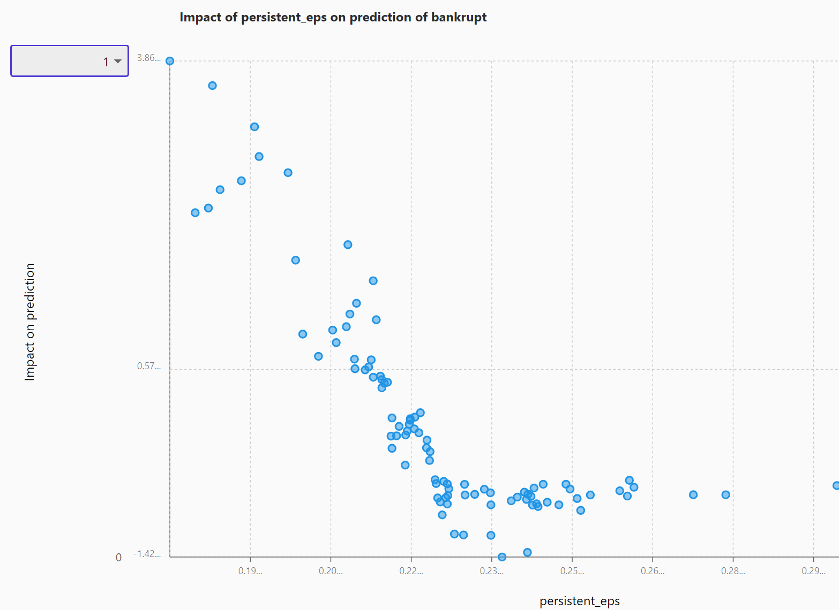
EDA Observation 1
As earnings per share increase (persistent_eps), we observe a corresponding decrease in the predicted likelihood of bankruptcy and vice versa.

Slide 14
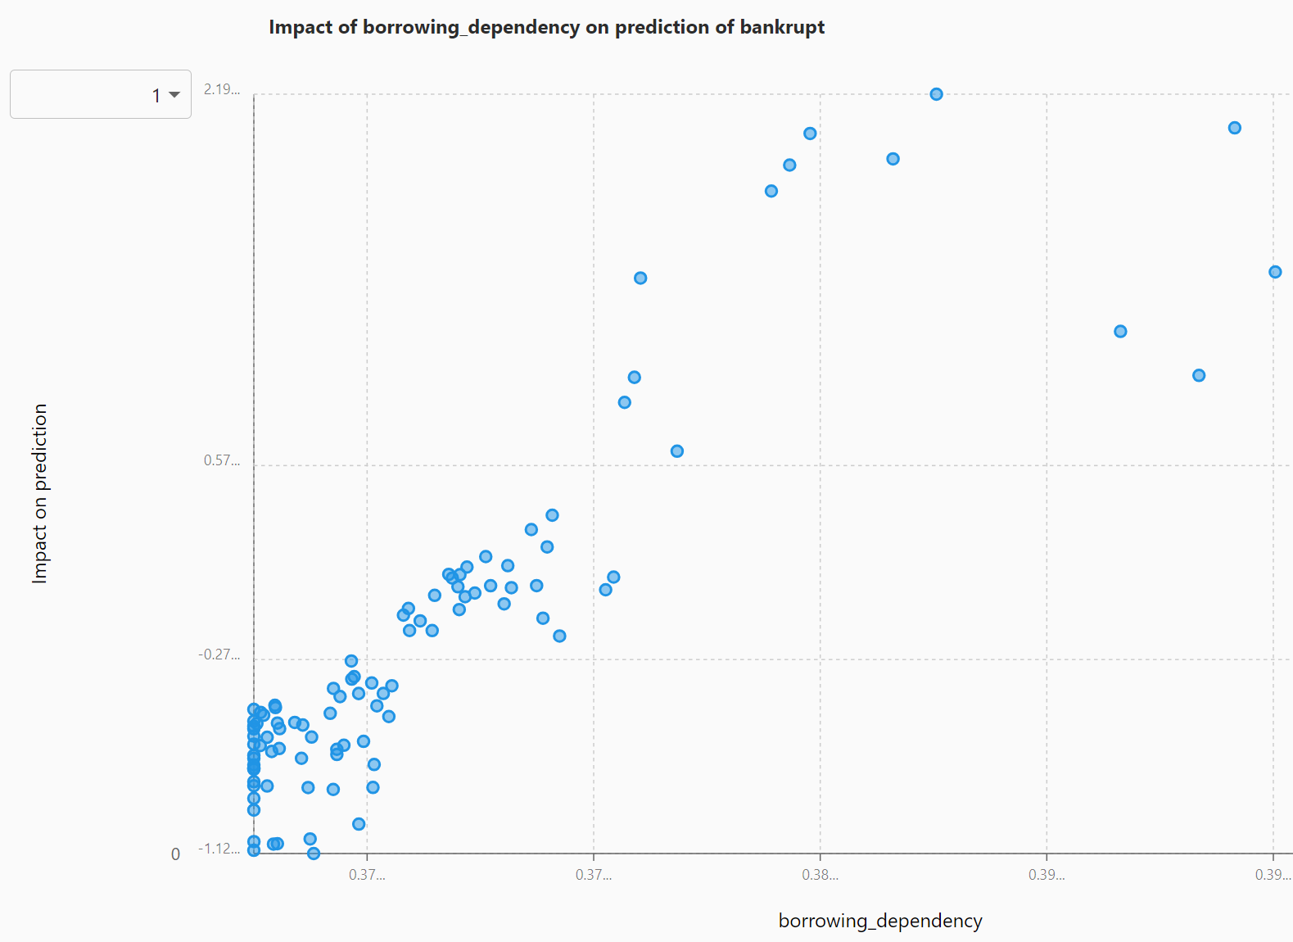
EDA Observation 2
We notice that higher borrowing dependency leads to a greater impact on the prediction of bankruptcy risk.

Slide 15
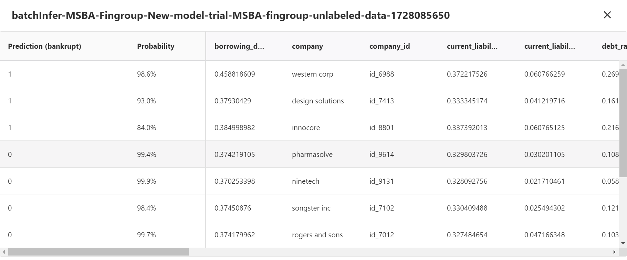

Slide 16
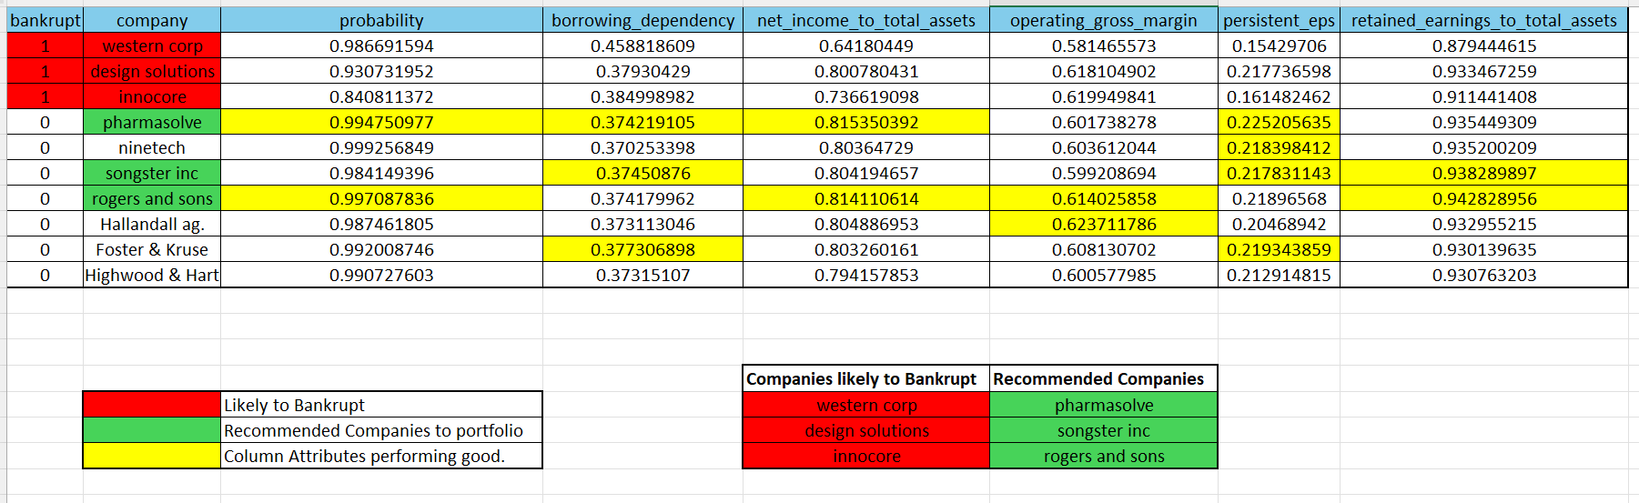
Recommendations from the prediction based on top-column attributes

Slide 17
Recommendations based on predictions for the new Portfolio:
Pharmasolve:
High Probability of not going bankrupt i.e., 0.9947.
Net income to total assets ratio is good i.e., 0.815.
Persistent EPS is doing good i.e., 0.225.
Songster Inc
High retained earnings to total assets ratio i.e., 0.9382
Good persistent EPS i.e., 0.217
Less borrowing dependency i.e., 0.374
Rogers & Sons
The probability of not going bankrupt is 0.997.
Net Income to Total Assets ratio is 0.814.
Operating Margin is good i.e., 0.614.
Retained Earnings to total assets is 0.942.

